Slide 1
Project 1: Flowchart
Akinola Oluwadamilola Nifemi

Slide 2
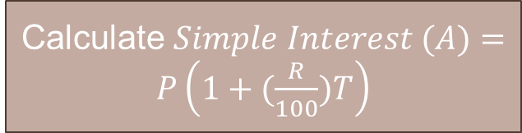
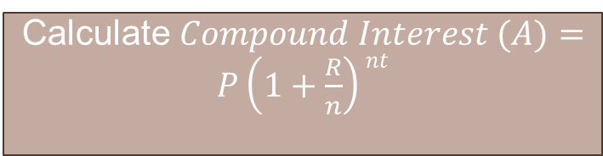
Get user’s name
Print welcome message
Print available formulas
Start
Is option = 1?
Input variables for simple interest
Select options (1-4)
Y
N
Calculate $Simple Interest (A)=P\left(1+(\frac{R}{100})T\right)$
Is option = 2?
Y
Input variables for compound interest
Print Simple Interest
Calculate $Compound Interest (A)=P\left(1+\frac{R}{n}\right)nt$
N
Print Compound Interest

Slide 3
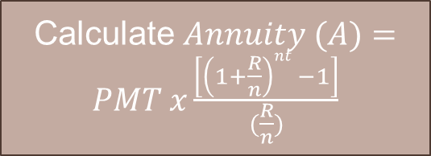
N
Is option = 3?
Is option = 4?
N
N
Print error and suggestion message
Y
Y
Input variables for Annuity
Print Thank you message
Calculate $Annuity (A)=PMT x\frac{\left[\left(1+\frac{R}{n}\right)nt −1\right]}{(\frac{R}{n})}$
Stop
Print Annuity

